Slide 1
Data-Intensive Scalable Computing in the Cloud
Lecture 2

Slide 2
Today
Homework review
Lecture: Scalability. MapReduce (with a nod to RDBMS)
Demo: Elastic MapReduce on AWS
Assignment: MapReduce algorithms, Elastic MapReduce performance

Slide 3
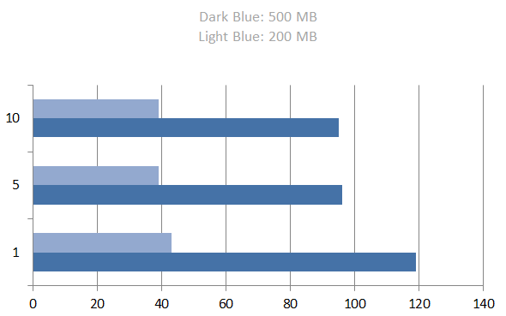
Homework
chunks
time (s)

Slide 4
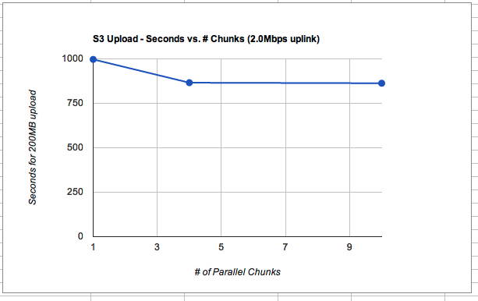
Homework

Slide 5
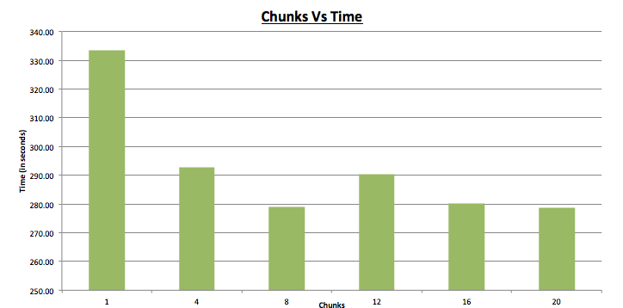
More chunks?

Slide 6
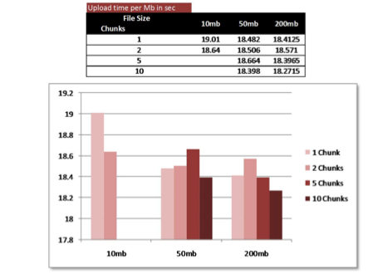

Slide 7
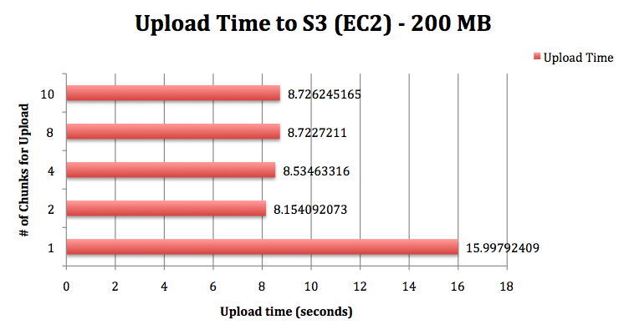
From EC2?

Slide 8
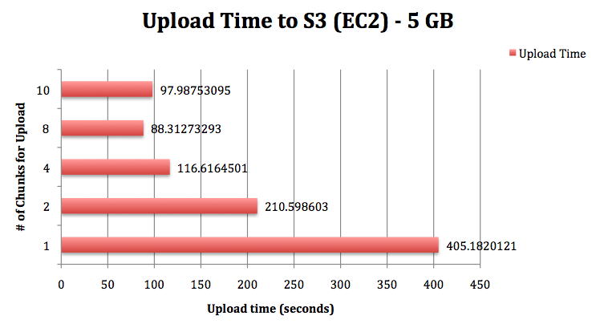

Slide 9
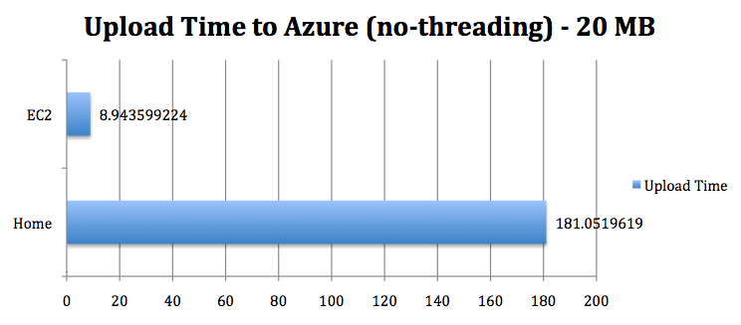
Fat Pipes between EC2 and Azure

Slide 10

Roadmap
Next Week: Iterative MapReduce
Guest lecture: Jaliya Ekanayake
Lead of Twister, Daytona
http://jaliyae.org/

Slide 11
Data-Intensive Scalable Computing

Slide 12
What Does Scalable Mean?
Operationally:
In the past: “Works even if data doesn’t fit in main memory”
Now: “Can make use of 1000s of cheap computers”
Formally:
In the past: If you have N data items, you must do no more than N^{k} operations -- “polynomial time algorithms”
Soon: If you have N data items, you must do no more than N * log(N) operations -- “logarithmic time algorithms”
Soon, you’ll only get one pass at the data
So you better make that one pass count

Slide 13
Example: Find matching sequences
Given a set of sequences
Find all sequences equal to “GATTACGATATTA”

Slide 14
TACCTGCCGTAA
GATTACGATATTA

Slide 15
GATTACGATATTA
TACCTGCCGTAA = GATTACGATATTA?
No.
time = 0

Slide 16
GATTACGATATTA
CCCCCAATGAC = GATTACGATATTA?
No.
time = 1

Slide 17
GATTACGATATTA
GATTACGATATTA contains GATTACGATATTA?
Yes!
Send it to the output.
time = 17

Slide 18
GATTACGATATTA
40 records, 40 comparions
N records, N comparisons
The algorithmic complexity is order N: O(N)

Slide 19
TTTTCGTAATT
AAAATCCTGCA
TTTACGTCAA
AAACGCCTGCA
GATTACGATATTA
What if we sort the sequences?

Slide 20
Start at the 50% mark
CTGTACACAACCT
GATTACGATATTA
0%
100%
CTGTACACAACCT < GATTACGATATTA
time = 0
No match.
Skip to 75% mark

Slide 21
GATTACGATATTA
GGATACACATTTA
0%
100%
GGATACACATTTA > GATTACGATATTA
time = 1
No match.
Go back to 62.5% mark

Slide 22
GATATTTTAAGC
GATTACGATATTA
0%
100%
GATATTTTAAGC < GATTACGATATTA
No match.
Skip back to 68.75% mark

Slide 23
GATTACGATATTA
0%
100%
GATTACGATATTA = GATTACGATATTA
Match!
Walk through the records until we fail to match.

Slide 24
GATTACGATATTA
0%
100%
How many comparisons did we do?
40 records, only 4 comparisons
N records, log(N) comparisons
This algorithm is O(log(N)) Far better scalability

Slide 25
Relational Databases
Databases are good at “Needle in Haystack” problems:
Extracting small results from big datasets
Transparently provide “old style” scalability
Your query will always* finish, regardless of dataset size.
Indexes are easily built and automatically used when appropriate
CREATE INDEX seq_idx ON sequence(seq);
SELECT seq
FROM sequence
WHERE seq = ‘GATTACGATATTA’;
*almost

Slide 26
New task: Read Trimming
Given a set of DNA sequences
Trim the final n bps of each sequence
Generate a new dataset

Slide 27
TACCTGCCGTAA
GATTACGATATTA

Slide 28
TACCTGCCGTAA becomes TACCT
time = 0

Slide 29
CCCCCAATGAC becomes CCCCC
time = 1

Slide 30
GATTACGATATTA becomes GATTA
time = 17

Slide 31
Can we use an index?
No. We have to touch every record no matter what.
The task is fundamentally O(N)
Can we do any better?

Slide 33
time = 0

Slide 34
time = 1

Slide 35
time = 2

Slide 36
time = 3

Slide 37
How much time did this take?
7 cycles
40 records, 6 workers
time = 7
O(N/k)

Slide 38
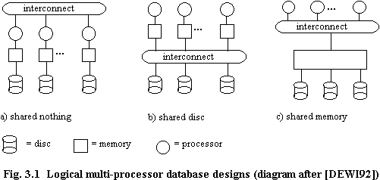
Taxonomy of Parallel Architectures
Scales to 1000s of computers
Easiest to program, but $$$$
Notes:
The goal here is to make Shared Nothing Architecturs easier to program.

Slide 39
Design Space
Grid
Internet
This talk
Data-
parallel
Dryad
Search
DISC
Shared
memory
Private
data
center
Transaction
HPC
Latency
Throughput
slide src: Michael Isard, MSR
39
Notes:
Dryad is optimized for: throughput, data-parallel computation, in a private data-center.
39

Slide 40
Some distributed algorithm…
Map
(Shuffle)
Reduce

Slide 41
MapReduce Programming Model
Input & Output: each a set of key/value pairs
Programmer specifies two functions:
Processes input key/value pair
Produces set of intermediate pairs
Combines all intermediate values for a particular key
Produces a set of merged output values (usually just one)
map (in_key, in_value) -> list(out_key, intermediate_value)
reduce (out_key, list(intermediate_value)) -> list(out_value)
Inspired by primitives from functional programming languages such as Lisp, Scheme, and Haskell
slide source: Google, Inc.

Slide 42
Example: What does this do?
map(String input_key, String input_value):
// input_key: document name
// input_value: document contents
for each word w in input_value:
EmitIntermediate(w, 1);
reduce(String output_key, Iterator intermediate_values):
// output_key: word
// output_values: ????
int result = 0;
for each v in intermediate_values:
result += v;
Emit(result);
slide source: Google, Inc.

Slide 43
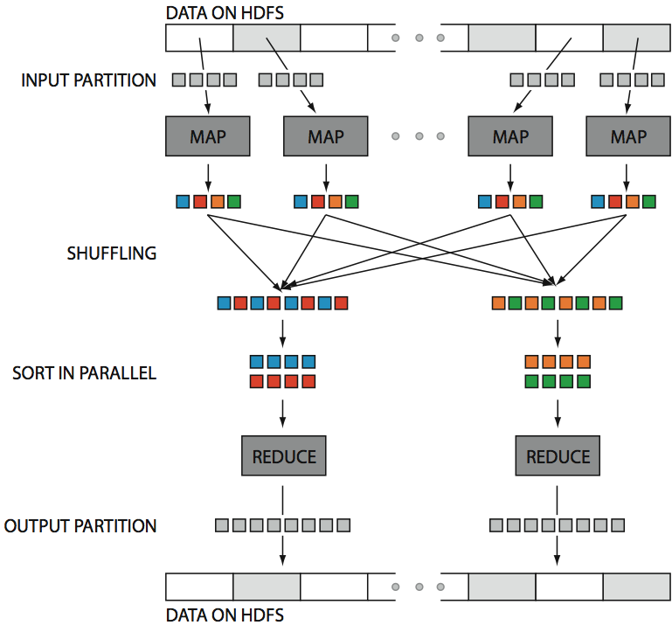
Hadoop in One Slide
src: Huy Vo, NYU Poly

Slide 44
Large-Scale Data Processing
Many tasks process big data, produce big data
Want to use hundreds or thousands of CPUs
... but this needs to be easy
Parallel databases exist, but they are expensive, difficult to set up, and do not necessarily scale to hundreds of nodes.
MapReduce is a lightweight framework, providing:
Automatic parallelization and distribution
Fault-tolerance
I/O scheduling
Status and monitoring

Slide 45
Relational Database History
Pre-Relational: if your data changed, your application broke.
Early RDBMS were buggy and slow (and often reviled), but required only 5% of the application code.
“Activities of users at terminals and most application programs should remain unaffected when the internal representation of data is changed and even when some aspects of the external representation are changed.”
-- Codd 1979
Key Ideas: Programs that manipulate tabular data exhibit an algebraic structure allowing reasoning and manipulation independently of physical data representation
Notes:
It provides a means of describing data with its natural structure only--that is, without superimposing any additional structure for machine representation purposes. Accordingly, it provides a basis for a high level data language which will yield maximal independence between programs on the one hand and machine representation on the other.

Slide 46
Key Idea: Data Independence
SELECT *
FROM my_sequences
views
logical data independence
SELECT seq
FROM ncbi_sequences
WHERE seq = ‘GATTACGATATTA’;
relations
physical data independence
f = fopen(‘table_file’);
fseek(10030440);
while (True) {
fread(&buf, 1, 8192, f);
if (buf == GATTACGATATTA) {
. . .
files and pointers

Slide 47
Key Idea: Indexes
Databases are especially, but exclusively, effective at “Needle in Haystack” problems:
Extracting small results from big datasets
Transparently provide “old style” scalability
Your query will always* finish, regardless of dataset size.
Indexes are easily built and automatically used when appropriate
CREATE INDEX seq_idx ON sequence(seq);
SELECT seq
FROM sequence
WHERE seq = ‘GATTACGATATTA’;
*almost

Slide 48
Key Idea: An Algebra of Tables
select
project
join
join
Other operators: aggregate, union, difference, cross product
Notes:
It turns out that you can express a wide variety of computations using only a handful of operators.

Slide 49
Key Idea: Algebraic Optimization
N = ((z*2)+((z*3)+0))/1
Algebraic Laws:
1. (+) identity: x+0 = x
2. (/) identity: x/1 = x
3. (*) distributes: (n*x+n*y) = n*(x+y)
4. (*) commutes: x*y = y*x
Apply rules 1, 3, 4, 2:
N = (2+3)*z
two operations instead of five, no division operator
Same idea works with the Relational Algebra!

Slide 50
Key Idea: Declarative Languages
Find all orders from today, along with the items ordered
SELECT *
FROM Order o, Item i
WHERE o.item = i.item
AND o.date = today()
join
o.item = i.item
select
date = today()
scan
scan
Item i
Order o

Slide 51
Shared Nothing Parallel Databases
Teradata
Greenplum
Netezza
Aster Data Systems
Datallegro
Vertica
MonetDB
Microsoft
Recently commercialized as “Vectorwise”

Slide 52
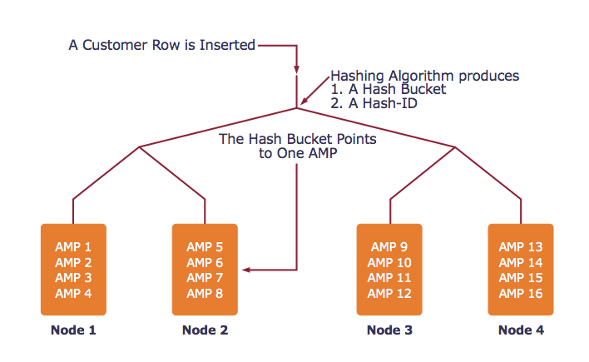
Example System: Teradata
AMP = unit of parallelism

Slide 53
Example System: Teradata
Find all orders from today, along with the items ordered
SELECT *
FROM Orders o, Lines i
WHERE o.item = i.item
AND o.date = today()
join
o.item = i.item
select
date = today()
scan
scan
Item i
Order o

Slide 54
Example System: Teradata
AMP 4
AMP 5
AMP 6
hash
hash
hash
h(item)
h(item)
h(item)
select
select
select
date=today()
date=today()
date=today()
scan
scan
scan
Order o
Order o
Order o
AMP 1
AMP 2
AMP 3

Slide 55
Example System: Teradata
AMP 4
AMP 5
AMP 6
hash
hash
hash
h(item)
h(item)
h(item)
scan
scan
scan
Item i
Item i
Item i
AMP 1
AMP 2
AMP 3

Slide 56
Example System: Teradata
join
join
join
o.item = i.item
o.item = i.item
o.item = i.item
AMP 4
AMP 5
AMP 6
contains all orders and all lines where hash(item) = 3
contains all orders and all lines where hash(item) = 2
contains all orders and all lines where hash(item) = 1

Slide 57
MapReduce Contemporaries
Dryad (Microsoft)
Relational Algebra
Pig (Yahoo)
Near Relational Algebra over MapReduce
HIVE (Facebook)
SQL over MapReduce
Cascading
Relational Algebra
Clustera
U of Wisconsin
Hbase
Indexing on HDFS

Slide 58
MapReduce vs RDBMS
RDBMS
Declarative query languages
Schemas
Logical Data Independence
Indexing
Algebraic Optimization
Caching/Materialized Views
ACID/Transactions
MapReduce
High Scalability
Fault-tolerance
“One-person deployment”
DryadLINQ, Pig, HIVE
HIVE, Pig, DryadLINQ
Hbase
Pig, (Dryad, HIVE)

Slide 59
Comparison
 | Data Model | Prog. Model | Services
GPL | * | * | Typing (maybe)
Workflow | * | dataflow | typing, provenance, scheduling, caching, task parallelism, reuse
Relational Algebra | Relations | Select, Project, Join, Aggregate, … | optimization, physical data independence, data parallelism
MapReduce | [(key,value)] | Map, Reduce | massive data parallelism, fault tolerance
MS Dryad | IQueryable, IEnumerable | RA + Apply + Partitioning | typing, massive data parallelism, fault tolerance
MPI | Arrays/ Matrices | 70+ ops | data parallelism, full control

Slide 60
Questions
Security?
Lock-in/Portability?
Others?

Slide 61
Part 2: Case Study

Slide 62
Amazon Web Services
History
Amazon Web Services

Slide 63
Amazon Web Services
Elastic Compute Cloud (EC2)
Rent various powers of computers by the hour
Simple Storage Service (S3)
Store the data from and for EC2 computers
Elastic Block Store (EBS)
Persistent attached storage for EC2 data
Relational Data Service (RDS)
Hosted, scalable MySQL Servers
Notes:
Amazon, the same company that used to sell books, has an enormous lead in providing outsourced computing.
They’re really ahead in the cloud.

Slide 64
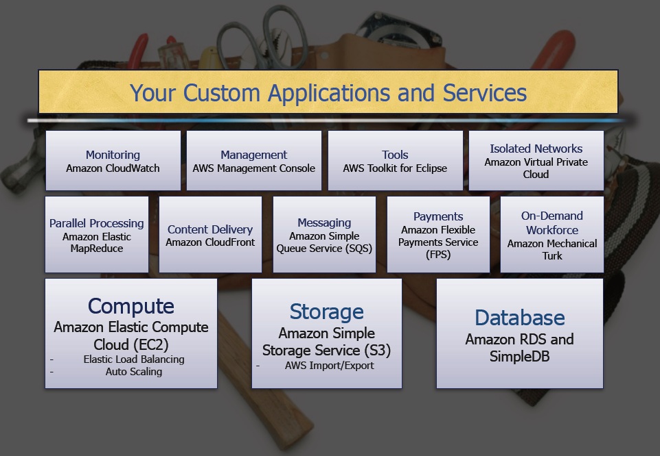
Amazon Web Services
[Deepak Singh, Amazon.com]

Slide 65
Amazon Machine Images
S3
AMI
EC2
Instance
EC2
Instance
AMI
EBS
Volume
AMI
Physical Machine
Physical Storage
Virtual
Physical

Slide 66
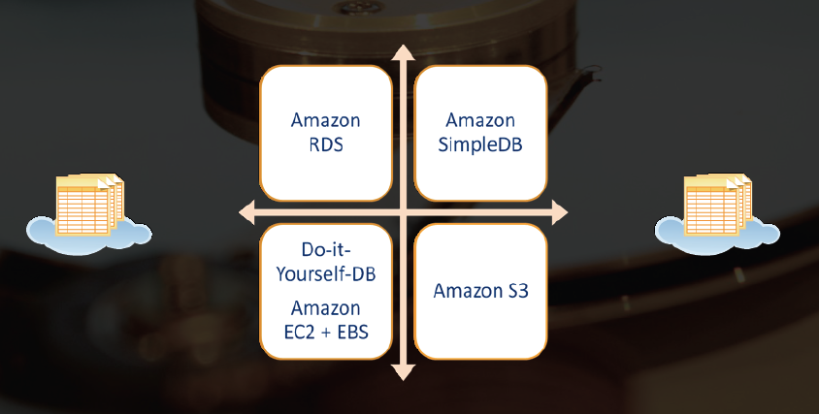
AWS Storage
[Deepak Singh, Amazon.com]

Slide 67
Amazon Web Services Prices
$0.10, RRS
Storage: $0.15/GB/month
Transfer in: $0.10/GB
Transfer out: $0.17/GB
EC2 small instance: $0.10/hour
EC2 XL instance: $0.80/hour
Ex: 5TB durably stored for 2 years, a 24/7 web server, a 24/7 database server, and 720 hours of 100 instances for big jobs….
~$24000
Notes:
One sysadmin for two years

Slide 68
Microsoft Azure

Slide 69

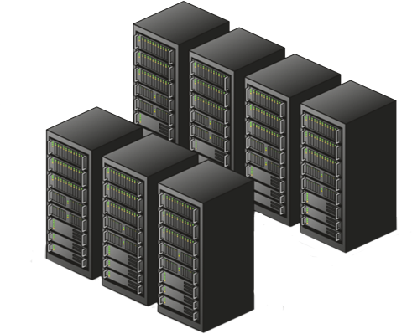
Azure FC Owns this Hardware
History
Highly-available
Fabric Controller (FC)
[Roger Barga, Microsoft]
Notes:
69

Slide 70


[Roger Barga, Microsoft]
Notes:
70

Slide 71
[Roger Barga, Microsoft]
Notes:
71

Slide 72
[Roger Barga, Microsoft]
Notes:
72

Slide 73

[Roger Barga, Microsoft]
Notes:
73

Slide 74





At Minimum
CPU: 1.5-1.7 GHz x64
Memory: 1.7GB
Network: 100⁺ Mbps
Local Storage: 500GB
Up to
CPU: 8 Cores
Memory: 14.2 GB
Local Storage: 2⁺ TB
[Roger Barga, Microsoft]
Notes:
74

Slide 75

Web Role
Worker Role
HTTP
ASP.NET, WCF, etc.
main()
{ … }
Load Balancer
IIS
Agent
Agent
Fabric
VM
[Roger Barga, Microsoft]
Notes:
75

Slide 76






HTTP
Blobs
Drives
Tables
Queues
Application
Compute
Storage
Fabric
…
[Roger Barga, Microsoft]
Notes:
76

Slide 77
AzureScope
http://azurescope.cloudapp.net/
Performance measurements
[Roger Barga, Microsoft]

Slide 78
Case StudY

Slide 79
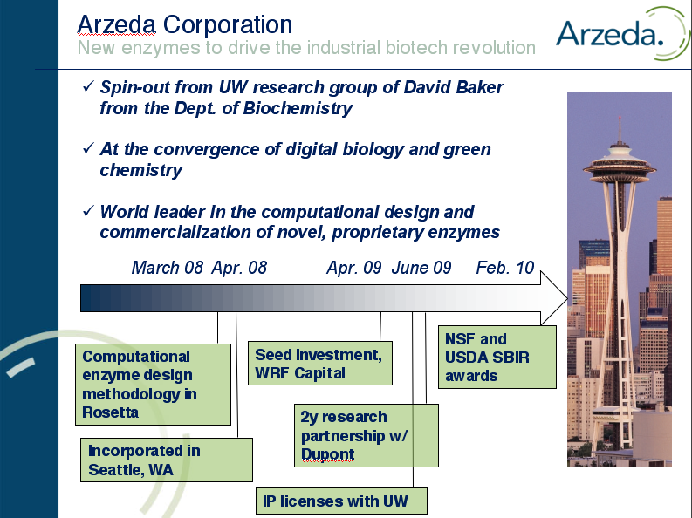
Notes:
Timeline : start w/ existing enzyme + funding + sign a dealm
Make sure to metnion the IP/tech license with UW
79

Slide 80
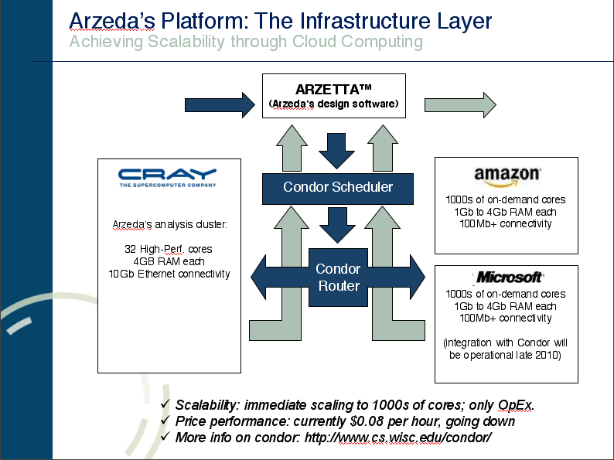

Slide 81
Application Scenarios

Slide 82



“Google Docs for developers”
The cloud is the ultimate collaborative development environmen
A shared environment outside of the jurisdiction of over-protective (or otherwise non-responsive) sysadmins
No bugs closed as “can’t replicate”
Example: New software for serving oceanographic model results, requiring collaboration between UW, OPeNDAP.org, and OOI
Bill Howe

Slide 83
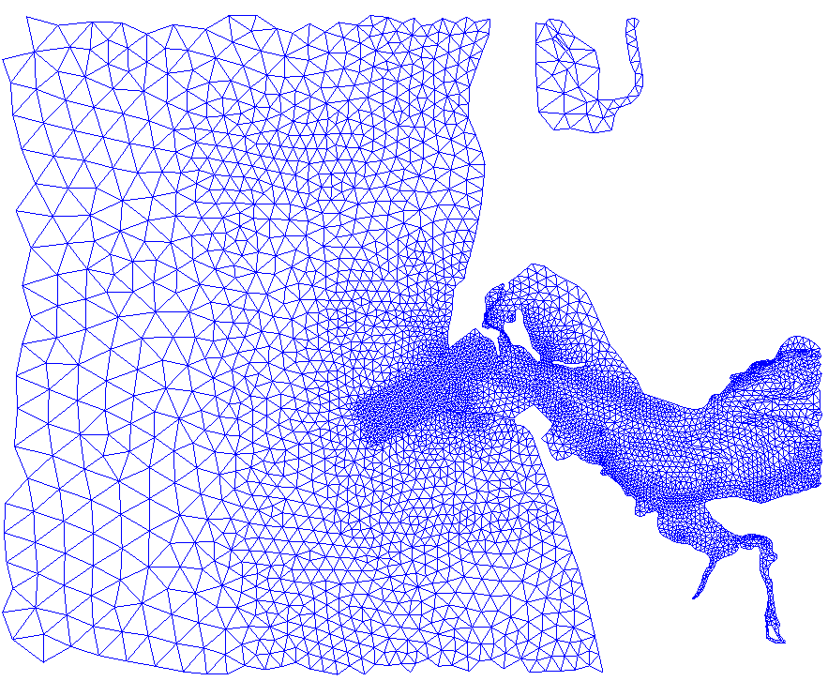
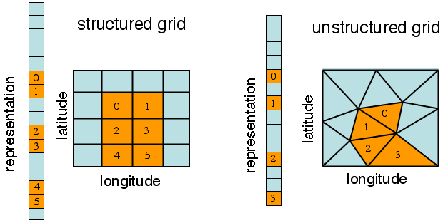
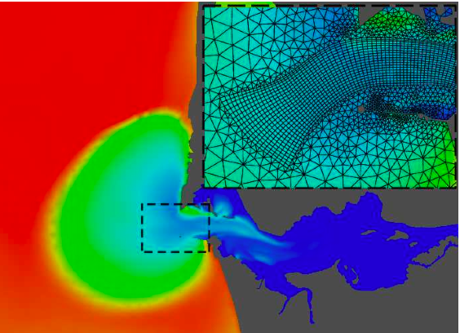

Waited two weeks for credentials to be established
Gave up, spun up an EC2 instance, were rolling within an hour
Similarly, Seattle’s Institute for Systems Biology uses EC2/S3 for sharing computational pipelines
Notes:
Project: New software for serving oceanographic model results, requiring collaboration between UW, OPeNDAP.org, and OOI.
Problem: Who wants to provide guest accounts for the other two?
Observation: EC2 is “Google Docs” for developers: a shared environment outside the jurisdiction of overprotective sysadmins.
Outcome: Waited two weeks for credentials to be established, then spun up an EC2 instance and were rolling within an hour. We can work on the same code base -- no bugs closed as “Can’t Replicate”
Conclusion: The cloud is the ultimate collaborative development environment.

Slide 84
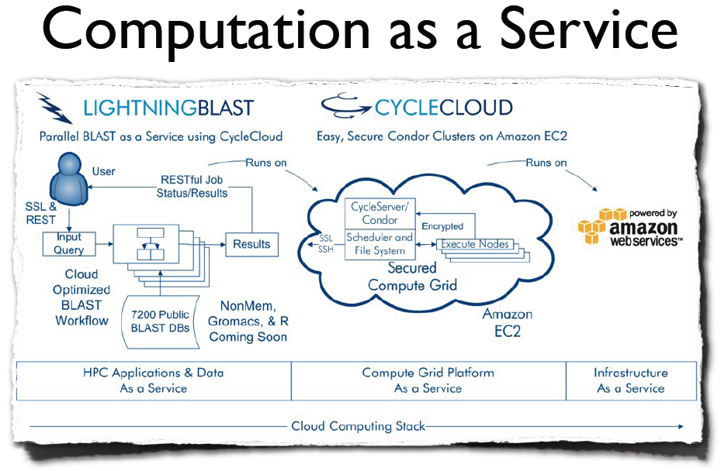

Slide 85
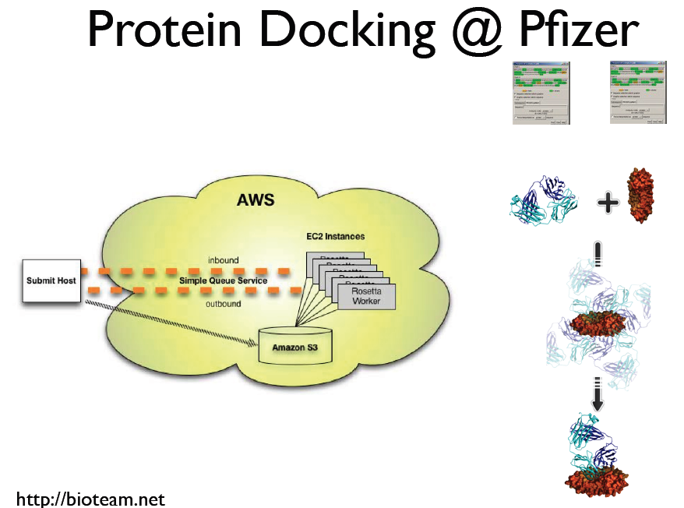

Slide 86
